Slide 1



PROJECT – I THE BATTLESHIP GAME
CME1251 Project Based Learning - I
by
2021510008 Alperen aydın
2020510010 arda Aslaner
2020510047 Bedirhan karaahmetlI
IZMIR

Slide 2
Contents
poster
INTRODUCTION
PROGRESS SUMMARY
Requirements
Task Sharing
Scheduling
Completed Tasks
Additional Improvements
PROBLEMS ENCOUNTERED
ALGORITHMS AND SOLUTION STRATEGIES
SCREENSHOTS
conclusıon
REFERENCES

Slide 3
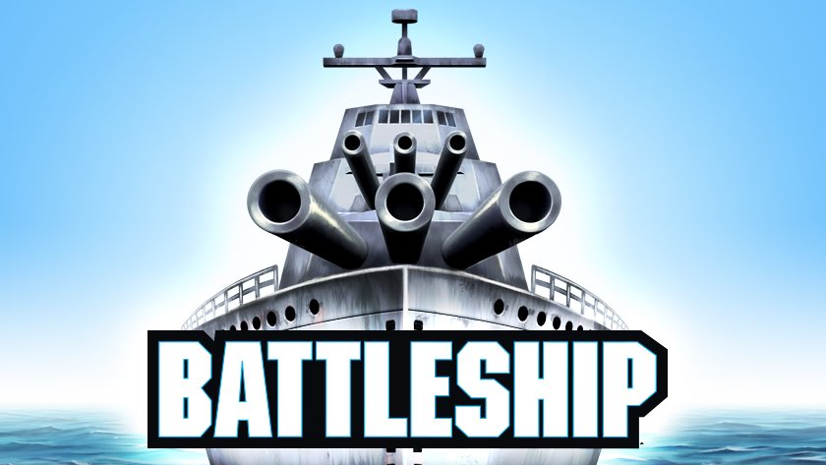


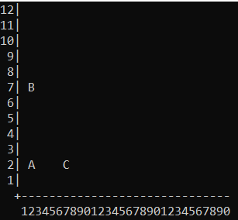
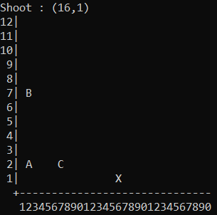
The Battleship Game is a strategy game. The game is played on a 12*30 game field. Player places the battleship on field. Computer makes a random shoot. If the battleship survives, the player gets points equal to the area of the battleship.
by
Alperen AYDIN Arda ASLANER Bedirhan KARAAHMETLİ
Lecturers Dr.Öğr.Üyesi Özlem AKTAŞ Arş.Gör. İlker KALAYCI
THE
💣
GAME

Slide 4
1.INTRODUCTION
• The Battleship Game is a strategy game. • The game is played on a 12*30 game field. • Player choose 3 coordinates for triangle battleship. • The selected coordinates are displayed on the screen. • Console displays ship info. • Computer makes a random shoot. • If the battleship survives, the player gets points equal to the area of the battleship. • If the user's score is sufficient, it will be listed in the high score table.

Slide 5
2.PROGRESS SUMMARY 2.1 REQUIREMENTS
• Doing research for mathematical formulas.
• Using various mathematical formulas for ships information.
• Teamwork

Slide 6
2.PROGRESS SUMMARY 2.2 TASk sharıng
• Alperen AYDIN designing and printing the playing field. Also checking the validity of the entered triangle. Finally, make the game playeable with all its rules. Editing codes.
• Arda ASLANER searching and printing simple properties of a triangle. Randomly shooting and display it in the coordinate plane. Finally, designing the menu. Editing codes.
•Bedirhan KARAAHMETLI obtaining the coordinates of the ship from the user and printing the ship to the playing field. Calculating and printing of advanced properties of triangle. Finally, making the high score table operations and remaining parts of the game. Editing codes.

Slide 7
2.PROGRESS SUMMARY 2.3 SCHEDULING
• In the first week, thoughts about the operation of the game were discussed. A flowchart was drawn to design the game. Solution strategies were determined.
• In the second week, the necessary variables for the game and the console screen were created. The ship has been drawn on the screen. Simple features of the ship were calculated using mathematical formulas.
• In the third week, the advanced features of the ship were calculated and printed on the screen. Triangle control achieved. Random shot is made by the computer and displayed in the playing field.
• In the last week, the menu was designed using loops. The game has been made playable with all its features. The high score table and the printing of the user score on the high score table were coded. Game bugs have been checked and fixed. The presentation, poster and report of the project were prepared.

Slide 8
2.PROGRESS SUMMARY 2.4 Completed tasks
• Flow chart was drawn. The ship was drawn on the screen and the console layout was provided. Calculation of the properties of the triangle is provided. Random shooting provided. The shot is displayed on the console. The menu design and the gameplay of the game have been checked.

Slide 9
2.PROGRESS SUMMARY 2.5 addıtıonal ımprovements
•User interface improvements have been made. •Wrong input errors were printed on the screen and the game was prevented from crashing. •Access to ship properties listing and shooting screen is blocked without receiving ship input. •The replayability of the game has been provided.

Slide 10
3.PROBLEMS ENCOUNTERED
• Fixed compatibility issue between Windows and Mac devices.
• The problem of closing the game due to invalid input has been resolved.
• Fixed shifts in the highscore table.

Slide 11
4.ALGORITHMS AND SOLUTION STRATEGIES
• Designing the menu and adding functionality using the do-while loop.
• Determining the type of triangle by comparing the side lengths of the triangle
• Using "try-parse" to prevent invalid entries from failing and displaying the necessary error messages to the player.

Slide 12
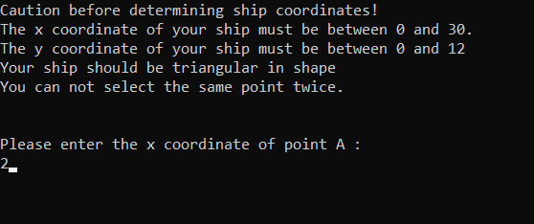
5.SCREENSHOTS Taking the coordinates from player

Slide 13
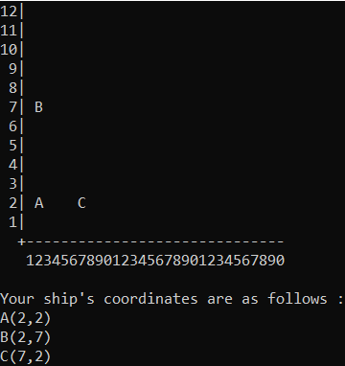
5.SCREENSHOTS Printing the ship

Slide 14
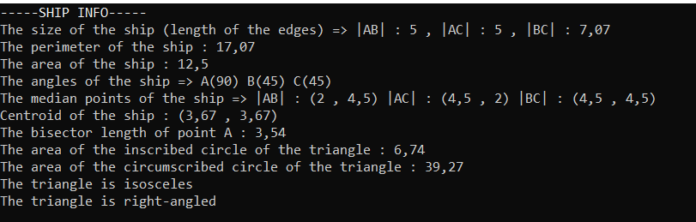
5.SCREENSHOTS Listing ship info

Slide 15
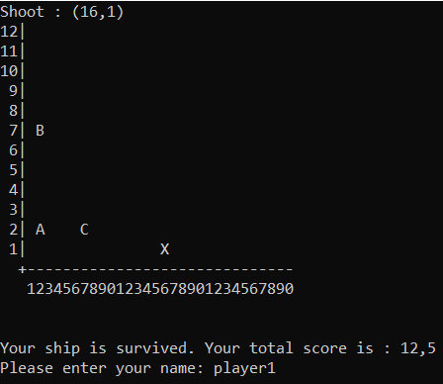
5.SCREENSHOTS Shooting

Slide 16
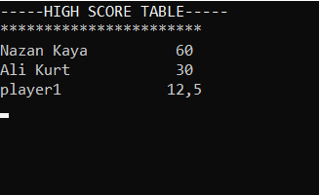
5.SCREENSHOTS High score table

Slide 17
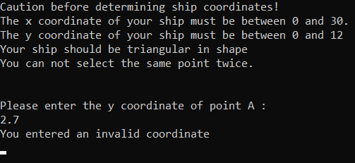
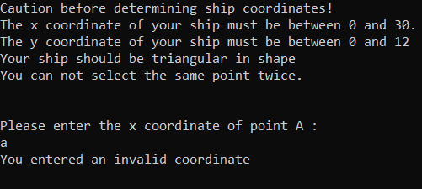
5.SCREENSHOTS Invalid inputs

Slide 18
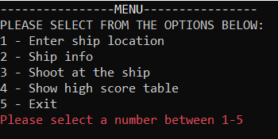
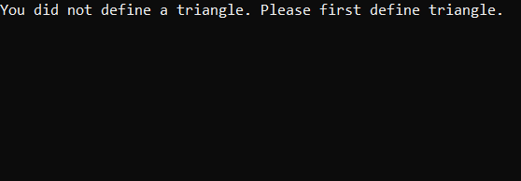
5.SCREENSHOTS Invalid inputs

Slide 19
CONCLUSION
• In this project, we designed a warship strategy game that can be played on console. At the start of the game, the coordinates of the triangular warship are requested from the user. The ship is placed on the playground. The characteristics of the ship were listed and the ship was randomly shot. Made a system of earning points if the ship survives.

Slide 20
6.REFERENCES
• https://docs.microsoft.com/tr-tr/dotnet/api/system.int32.tryparse?view=net-5.0
• https://proofwiki.org/wiki/Length_of_Angle_Bisector
• https://byjus.com/maths/triangles/
• https://docs.microsoft.com/en-us/dotnet/csharp/programming-guide/
• https://en.wikipedia.org/wiki/Main_Page
• https://www.geeksforgeeks.org/console-class-in-c-sharp/

